Slide 1
UMD DATA605 - Big Data Systems Graph Data Processing Giraph, GraphX
GP Saggese
gsaggese@umd.edu
with thanks to Amol Deshpande,
Sebastian Schelter (TU Berlin), Roman Shaposhnik (Apache),
Claudio Martella (Apache), Joseph Gonzalez (UC Berkeley)

Slide 2
Options for Processing Graph Data
Write your own programs
Extract the relevant data, and construct an in-memory graph
Different storage options help to different degrees with this
Write queries in a declarative language
Works for some classes of graph queries/tasks
E.g., cypher for Neo4j
Use a general-purpose distributed programming framework
E.g.: Hadoop or Spark
Hard to program many graph analysis tasks this way
Use a graph-specific programming framework
Goal is to simplify writing graph analysis tasks, and scale them to very large volumes at the same time
E.g., Giraph or GraphX

Slide 3
Option 2: Declarative Interfaces
No consensus on declarative, high-level languages (like SQL) for either querying or for analysis
Too much variety in the types of queries/analysis tasks
Makes it hard to find and exploit commonalities
Some limited, but useful solutions:
XQuery for XML
Limited to tree-structured data
SPARQL for RDF
Standardized query language, but limited functionality
Cypher by Neo4j
Datalog-based frameworks for specifying analysis tasks
Many prototypes, typically specific to some analysis task

Slide 4
Option 3: MapReduce
A popular option for (batch) processing very large datasets, as we know
More specifically: Hadoop or Spark
Two key advantages:
Scalability without worrying about scheduling, distributed execution, fault tolerance, and so on...
Relatively simple programming framework
Disadvantages:
Hard to use directly for graph analysis tasks
Each “traversal” effectively requires a new “map-reduce” phase
Hadoop framework not ideal for large numbers of phases, Spark is better, though
However, much work on showing how different graph analysis tasks can be done using MapReduce

Slide 5
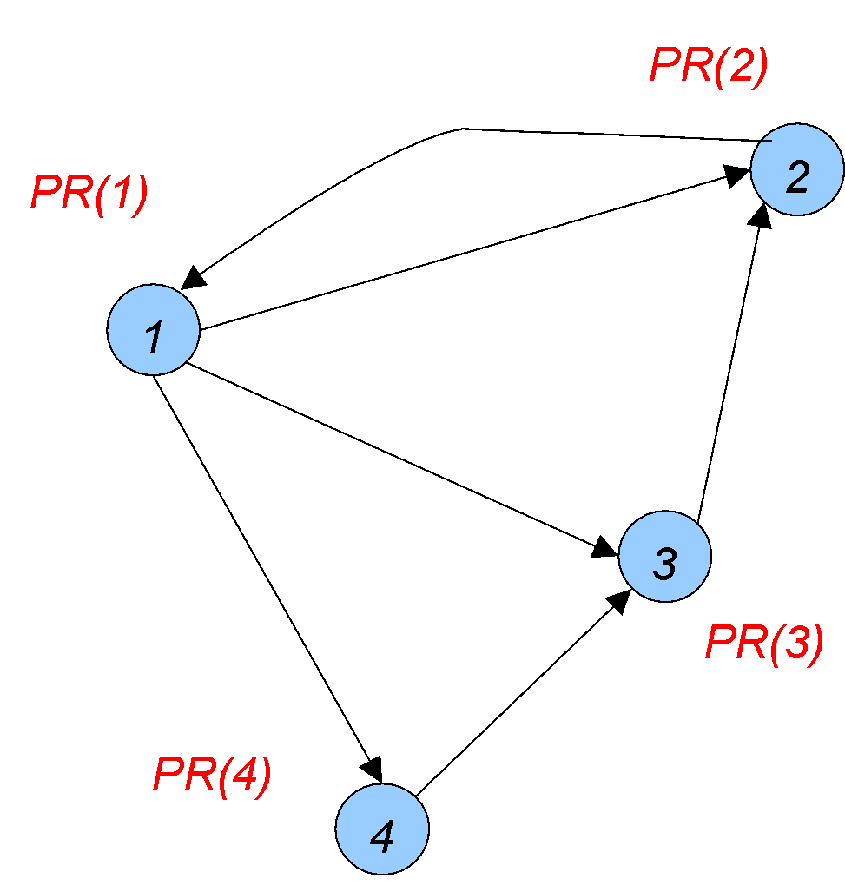
Example Algorithm: PageRank
PageRank: A measure of centrality of a node
PR(node) = Probability that a random surfer ends up at that node
Probability of jumping to a random node
PR(2) = α/4 + (1- α)(PR(1)/3 + PR(3) )
PageRank of node 3
PageRank of node 1 distributed over its out-edges
This formula defines a probability distribution over the nodes

Slide 6
PageRank
Damping factor 𝛂 needed to handle nodes with 0 out-degree and other special cases
Surfer may jump to a random page with probability 𝛂 and restart
How to compute?
Algebraically: using Matrix Multiplication
PageRank p is the principal eigenvector of the Markov matrix M defined by the transition probabilities between web pages
it can be obtained by iteratively multiplying an initial PageRank vector by M (power iteration)
p = M^{k} p₀
Not scalable to large graphs
Iteratively:
For the first iteration: PR(n) = 1/N for all nodes
Repeatedly apply the formula using the PR() values from the previous iteration
Typically 25-50 iterations enough to converge

Slide 7
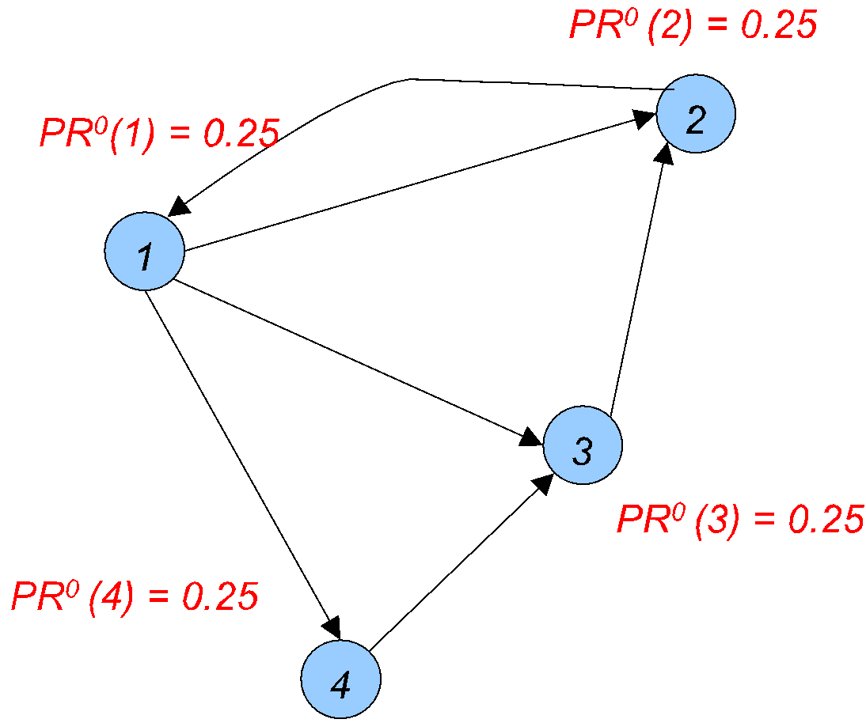
PageRank
Iterative approach:
Compute PR¹(1), ..., using PR⁰(1), ...
E.g., PR¹(2) =
𝛂/4 +
(1 – 𝛂) (PR⁰(1)/3 + PR⁰(3))

Slide 8
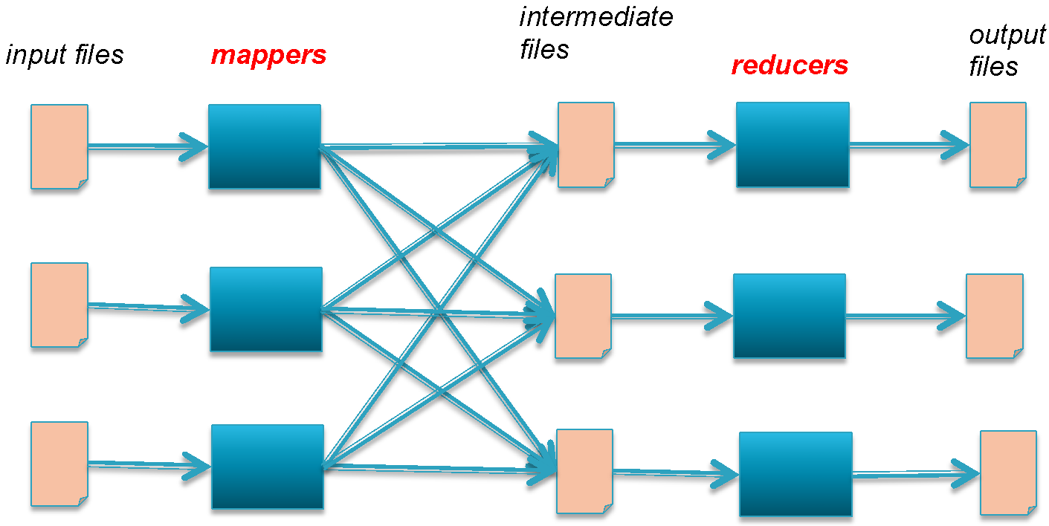
Option 3: MapReduce – PageRank
All mappers run in parallel, typically on separate machines Then all reducers run in parallel, typically on separate machines
All the files are stored in a distributed file system (HDFS)

Slide 9
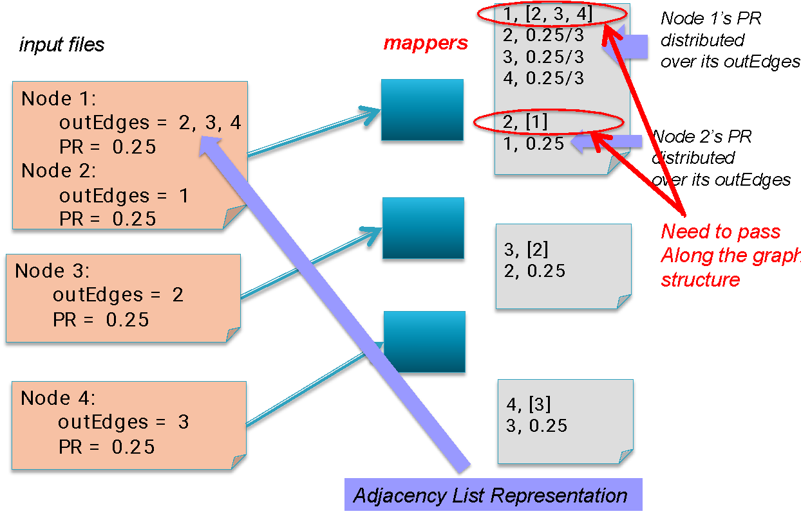
Option 3: MapReduce – PageRank

Slide 10
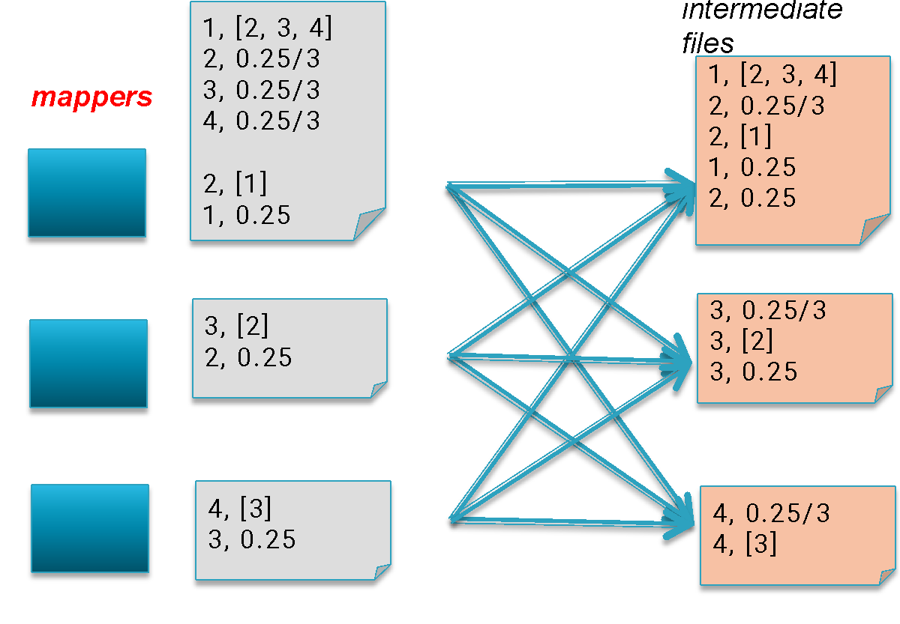
Option 3: MapReduce – PageRank
“Shuffle” so that all the records with the same “key” end up in the same file

Slide 11
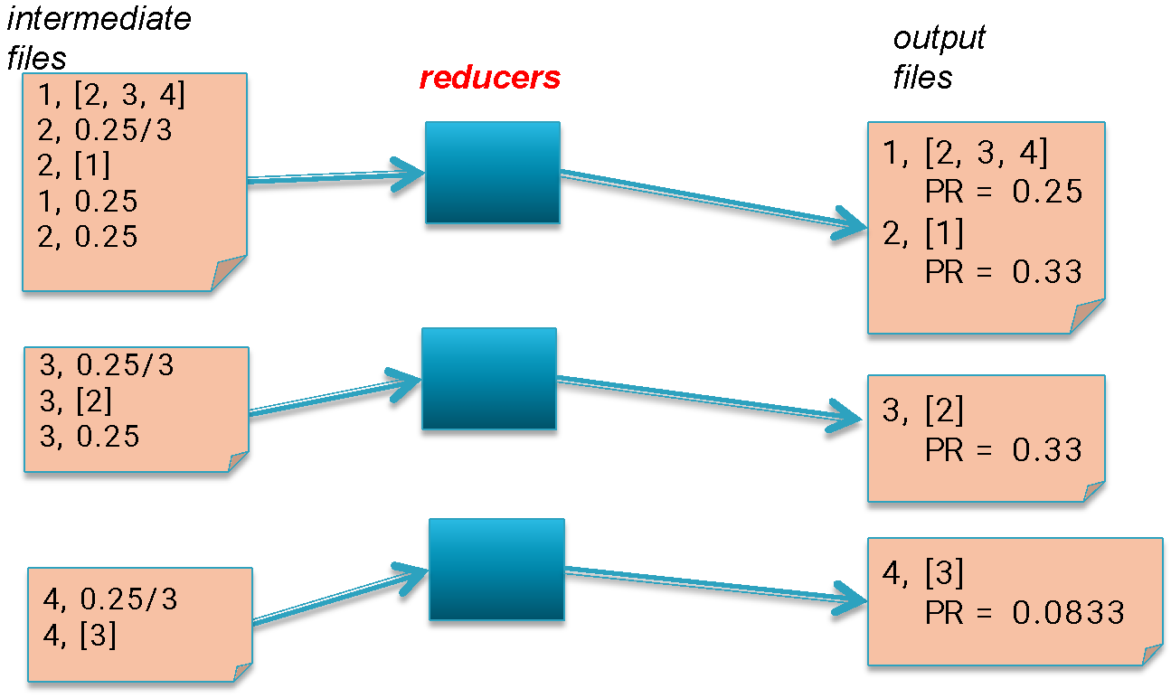
Option 3: MapReduce – PageRank
Reduce: Compute the new PageRank (assume 𝛂 = 0) Write out: graph structure + PageRank

Slide 12
Option 3: MapReduce – PageRank
REPEAT UNTIL CONVERGENCE

Slide 13
Option 3: MapReduce
Disadvantages:
Hard to use this for graph analysis task
Each “traversal” effectively requires a new “map-reduce” phase
Each job is execute N times
Hadoop framework not ideal for large numbers of phases (even with YARN)
Not efficient – too much redundant work
Mappers send PR values and structure of graph
In PageRank example: repeated reading and parsing of the inputs for each iteration
Extensive I/O at input, shuffle/sort, output

Slide 14
Option 4: Graph Programming Frameworks
Frameworks (analogous to MapReduce) proposed for analyzing large volumes of graph data
An attempt at addressing limitations of MapReduce
Most are vertex-centric
Programs written from the point of view of a vertex
Most based on message passing between nodes
Pregel: original framework proposed by Google
Based on “Bulk Synchronous Parallel” (BSP) model
Giraph: an open-source implementation of Pregel built on top of Hadoop
GraphLab: asynchronous execution
GraphX: built on top of Spark

Slide 15
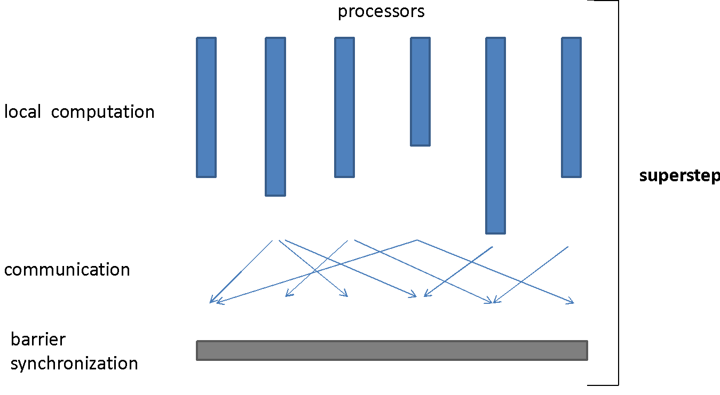
Bulk Synchronous Parallel (BSP)
time

Slide 16
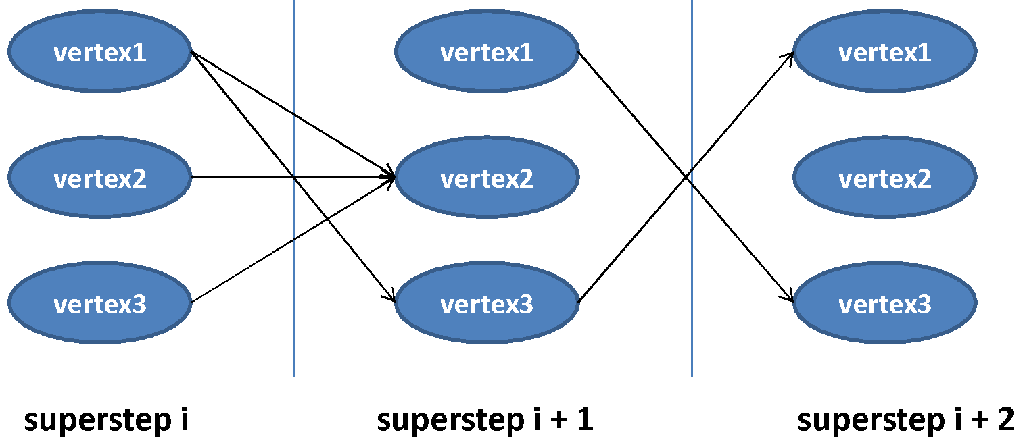
Vertex-centric BSP
Each vertex has an id, a value, a list of its adjacent vertex ids and the corresponding edge values
Each vertex is invoked in each superstep, can recompute its value and send messages to other vertices, which are delivered over superstep barriers
Advanced features : termination votes, combiners, aggregators, topology mutations

Slide 17
Think like a vertex
I know my local state
I know my neighbours
I can send messages to vertices
I can declare that I am done
I can mutate graph topology

Slide 18
Option 4: Pregel
Programmers write one program: compute()
Typical structure of compute():
Inputs: current values associated with the node
Inputs: messages sent by the neighboring nodes
Do something …
Modify current values associated with the node (if desired)
Outputs: send messages to neighbors
Execution framework:
Execute compute() for all the nodes in parallel
Synchronize (wait for all messages to be delivered)
Repeat

Slide 19
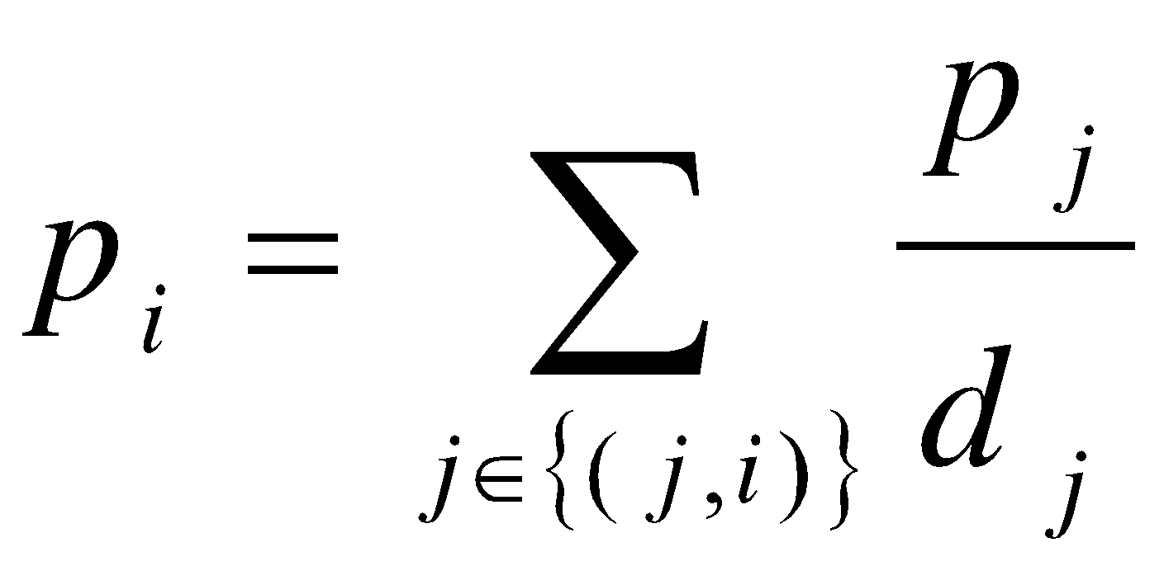
PageRank in Pregel
class PageRankVertex { void compute(Iterator messages) {
if (getSuperstep() > 0) {
// recompute own PageRank from the neighbors messages
pageRank = sum(messages);
setVertexValue(pageRank);
}
if (getSuperstep() < k) {
// send updated PageRank to each neighbor
sendMessageToAllNeighbors(pageRank / getNumOutEdges());
} else {
voteToHalt(); // terminate }
}
}

Slide 20
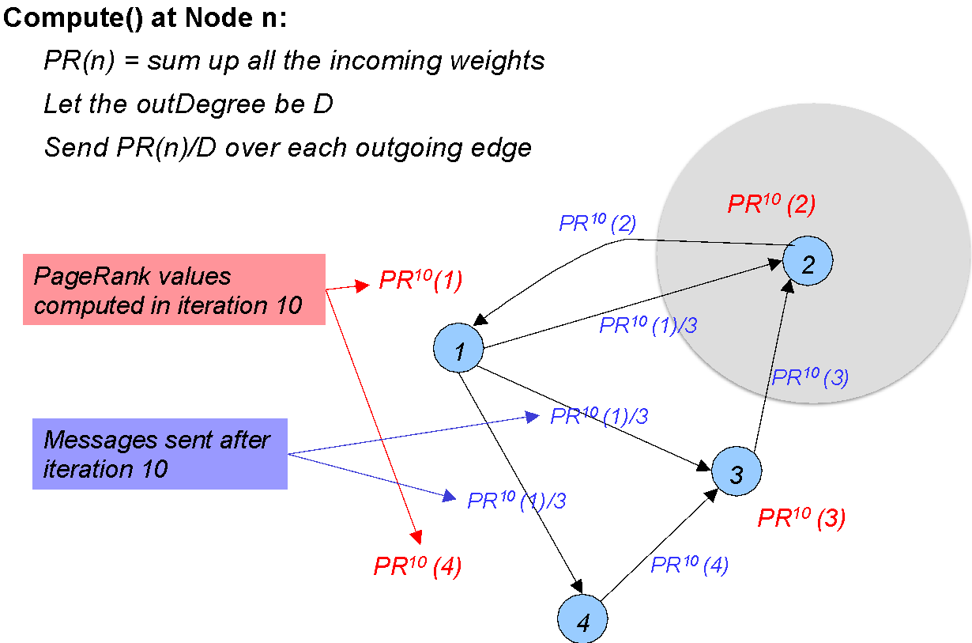
PageRank in Pregel

Slide 21
Apache giraph

Slide 22
Apache Giraph
Pregel is proprietary, but:
Apache Giraph is an open source implementation of Pregel
runs on standard Hadoop infrastructure
computation is executed in memory
can be a job in a pipeline (MapReduce, Hive)
uses Apache ZooKeeper for synchronization
graph partition via hashing
fault tolerance via checkpointing

Slide 23
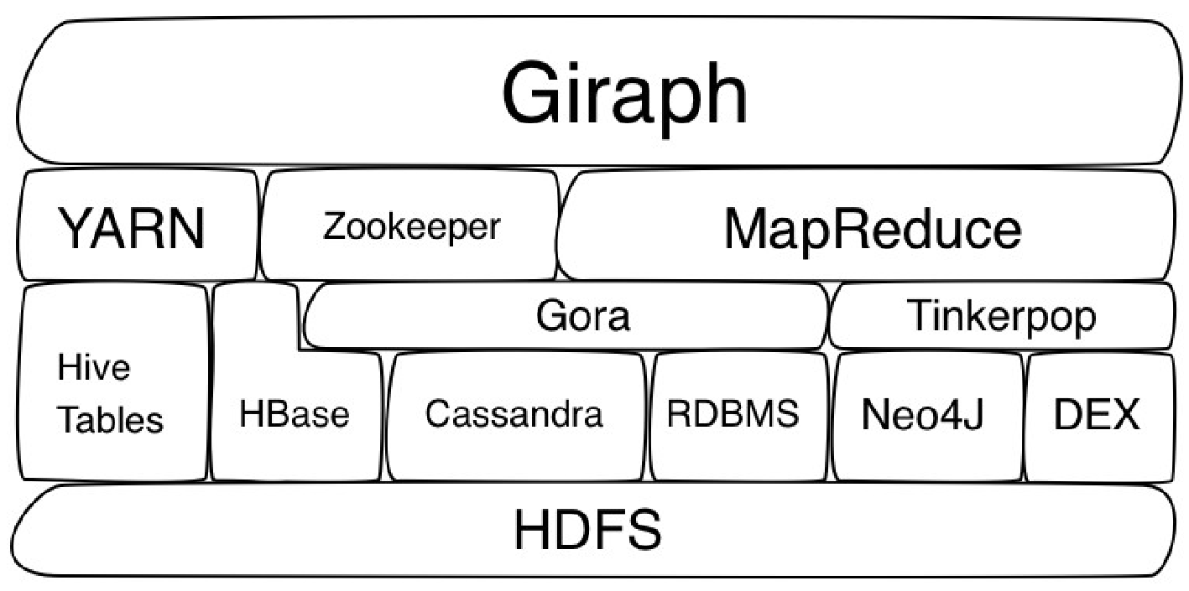
Plays well with Hadoop

Slide 24
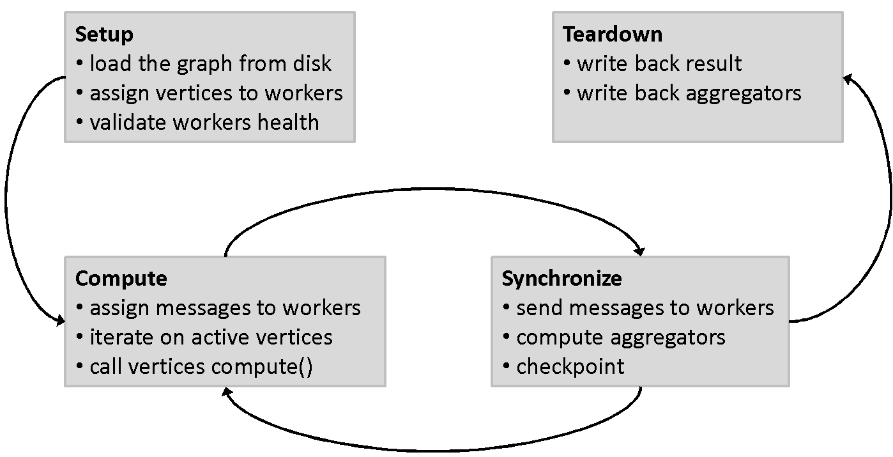
Giraph Execution

Slide 25
Which part is doing what?
ZooKeeper: responsible for computation state
partition/worker mapping
global state: #superstep
checkpoint paths, aggregator values, statistics
Master: responsible for coordination
assigns partitions to workers
coordinates synchronization
requests checkpoints
aggregates aggregator values
collects health statuses
Worker: responsible for vertices
invokes active vertices compute() function
sends, receives and assigns messages
computes local aggregation values

Slide 26
What do you have to implement?
Your algorithm as a Vertex
Subclass one of the many existing implementations: BasicVertex, MutableVertex, EdgeListVertex, HashMapVertex, LongDoubleFloatDoubleVertex, ...
A VertexInputFormat to read your graph
e.g., from a text file with adjacency lists like <vertex> <neighbor1> <neighbor2> …
a VertexOutputFormat to write back the result
e.g., <vertex> <pageRank>

Slide 27
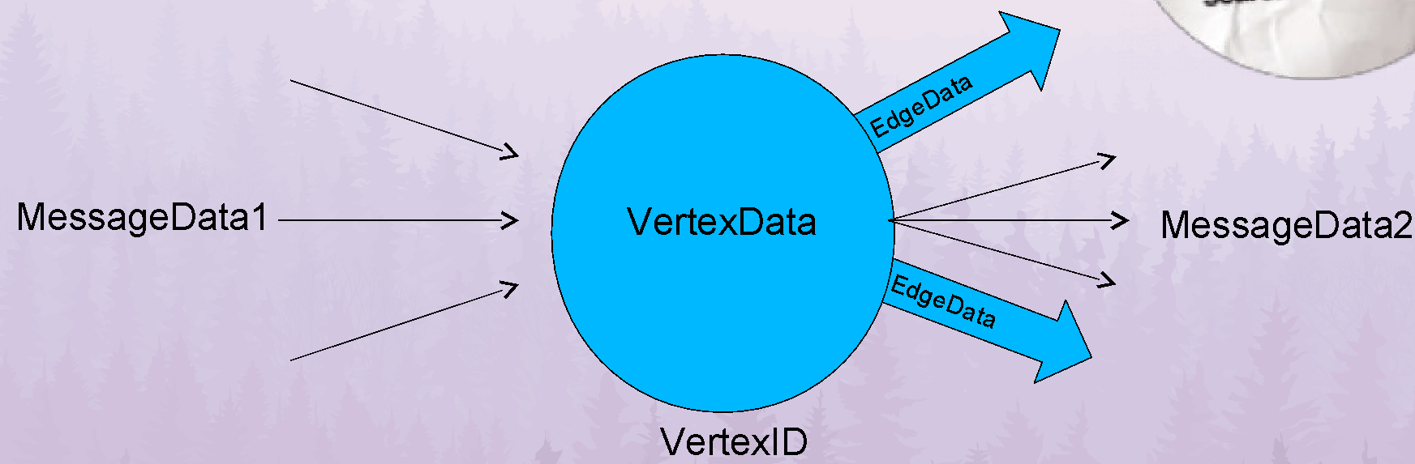
A vertex view

Slide 28
Designed for iterations
Stateful (in-memory)
Keep all data in memory if possible
Only intermediate values (messages) sent
To communicate with other vertices
Hits the disk at input, output, checkpoint
Can go out-of-core
If the data does not fit into memory

Slide 29
Graph modeling in Giraph
BasicComputation< I extends WritableComparable, // VertexID -- vertex ref V extends Writable, // VertexData -- a vertex datum E extends Writable, // EdgeData -- an edge label M extends Writable> // MessageData-– message payload

Slide 30
Giraph “Hello World”
public class GiraphHelloWorld extends BasicComputation<IntWritable, IntWritable, NullWritable, NullWritable> {
public void compute(Vertex<IntWritable, IntWritable, NullWritable> vertex, Iterable<NullWritable> messages) {
System.out.println(“Hello world from the: “ + vertex.getId() + “ : “); for (Edge<IntWritable, NullWritable> e : vertex.getEdges()) {
System.out.println(“ “ + e.getTargetVertexId()); }
System.out.println(“”); vertex.voteToHalt();
}
}

Slide 31
Example: Ping neighbors
public void compute(Vertex<Text, DoubleWritable, DoubleWritable> vertex, Iterable<Text> ms ){
if (getSuperstep() == 0) { sendMessageToAllEdges(vertex, vertex.getId());
} else { for (Text m : ms) {
if (vertex.getEdgeValue(m) == null) { vertex.addEdge(EdgeFactory.create(m, SYNTHETIC_EDGE)); } }
} vertex.voteToHalt(); }

Slide 32
Giraph PageRank Example
public class PageRankComputation extends BasicComputation<IntWritable, FloatWritable, NullWritable, FloatWritable> {
/** Number of supersteps */
public static final String SUPERSTEP_COUNT = "giraph.pageRank.superstepCount";

Slide 33
Giraph PageRank Example
public void compute(Vertex<IntWritable, FloatWritable, NullWritable> vertex, Iterable<FloatWritable> messages) throws IOException {
if (getSuperstep() >= 1) {
float sum = 0;
for (FloatWritable message : messages) {
sum += message.get();
}
vertex.getValue().set((0.15f / getTotalNumVertices()) + 0.85f * sum);
}
if (getSuperstep()<getConf().getInt(SUPERSTEP_COUNT, 0)) {
sendMessageToAllEdges(vertex,
new FloatWritable(vertex.getValue().get() / vertex.getNumEdges()));
} else {
vertex.voteToHalt();
}
}
}

Slide 34
Additional functionality
Combiners
To minimize messages
Aggregators
global aggregations across vertices
MasterCompute
computation executed on master
WorkerContext
executed per worker task
PartitionContext
executed per partition

Slide 35
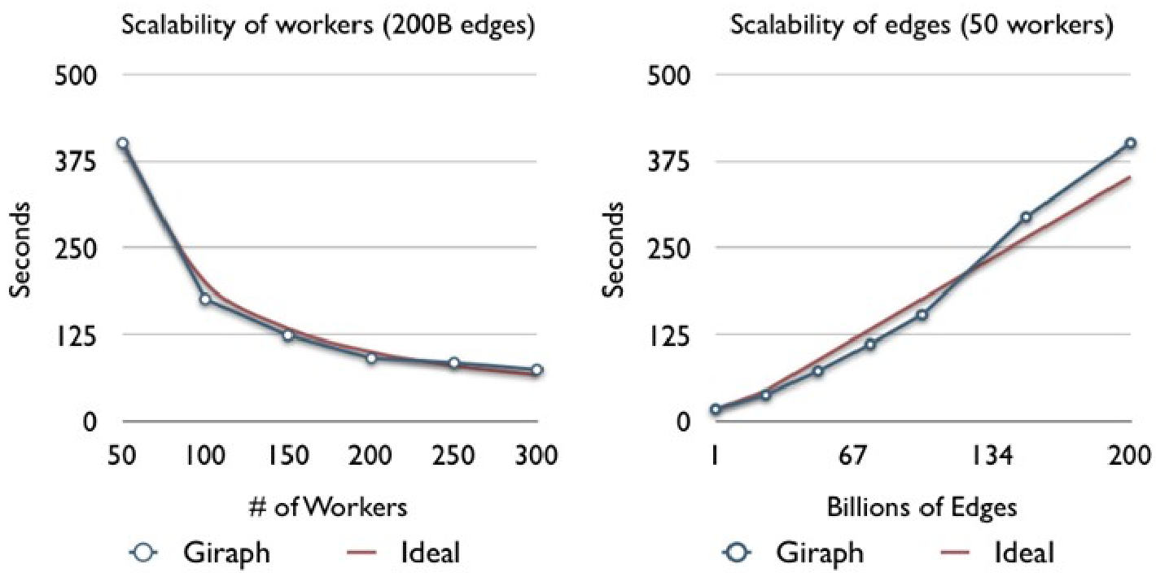
Giraph scales
https://www.facebook.com/notes/facebook-engineering/scaling-apache-giraph-to-a-trillion-edges/10151617006153920

Slide 36
Graphx

Slide 37
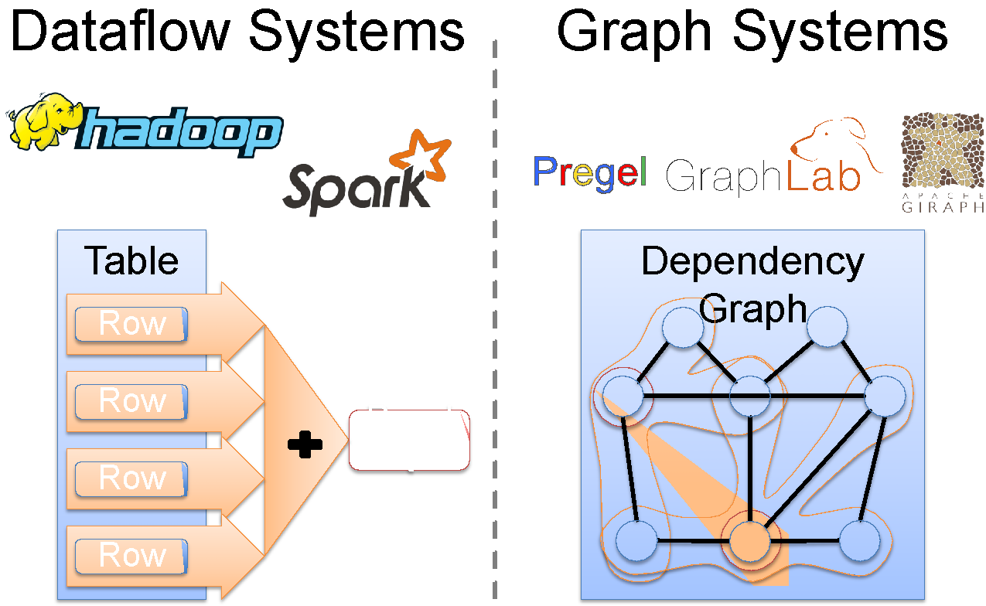
GraphX Motivation

Slide 38

GraphX Motivation
Difficult to Program and Use
Users must Learn, Deploy, and
Manage multiple systems
Leads to brittle and often complex interfaces

Slide 39
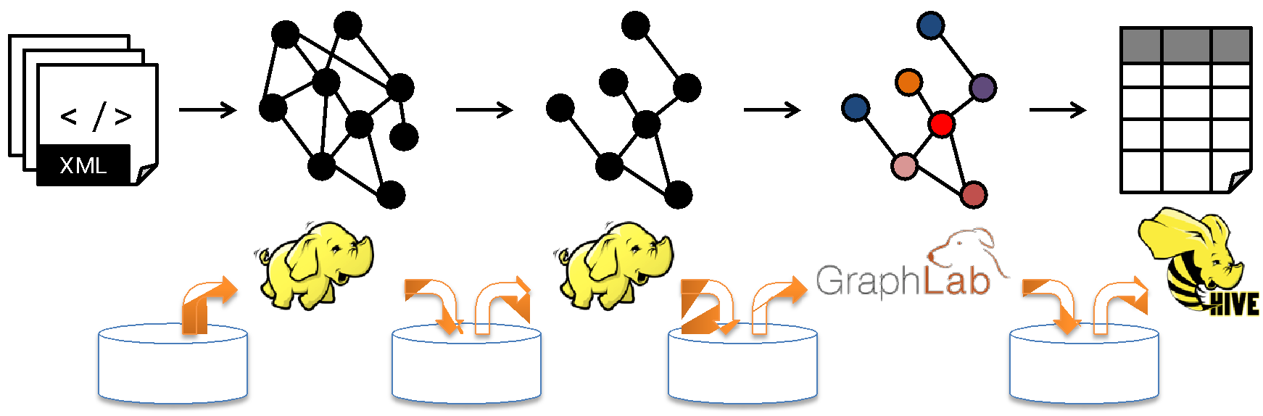
And Inefficient
Extensive data movement and duplication across the network and file system
Limited reuse of internal data-structures across stages

Slide 40
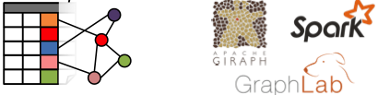
The GraphX Unified Approach
New API
Blurs the distinction between Tables and Graphs
New System
Combines Data-Parallel Graph-Parallel Systems
Enables users to easily and efficiently express the entire graph analytics pipeline

Slide 41
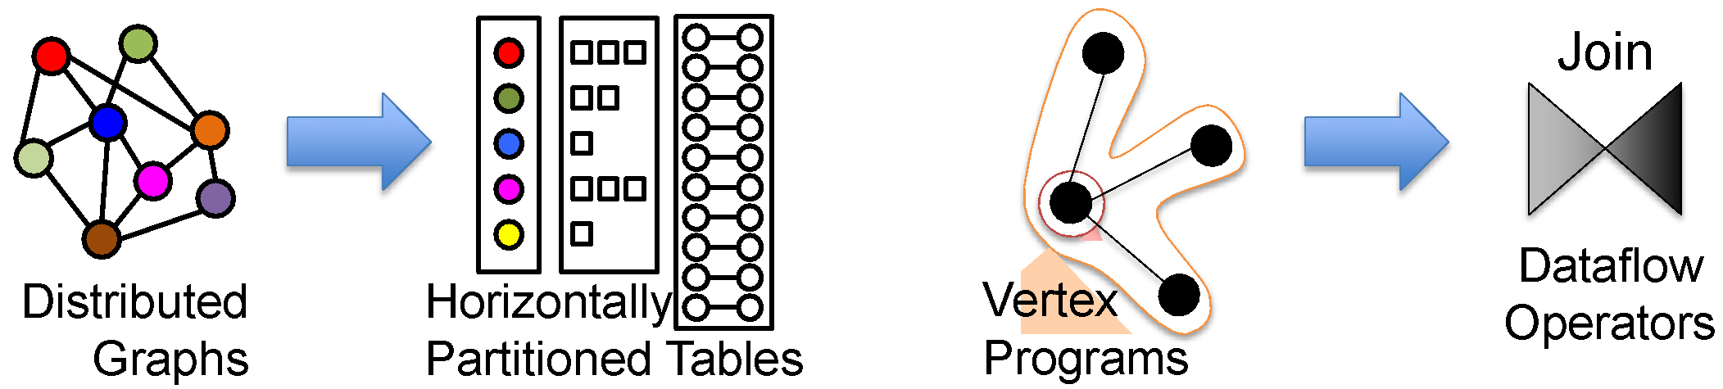
Representation
Plus optimizations:
Distributed join optimization
Materialized view maintenance

Slide 42
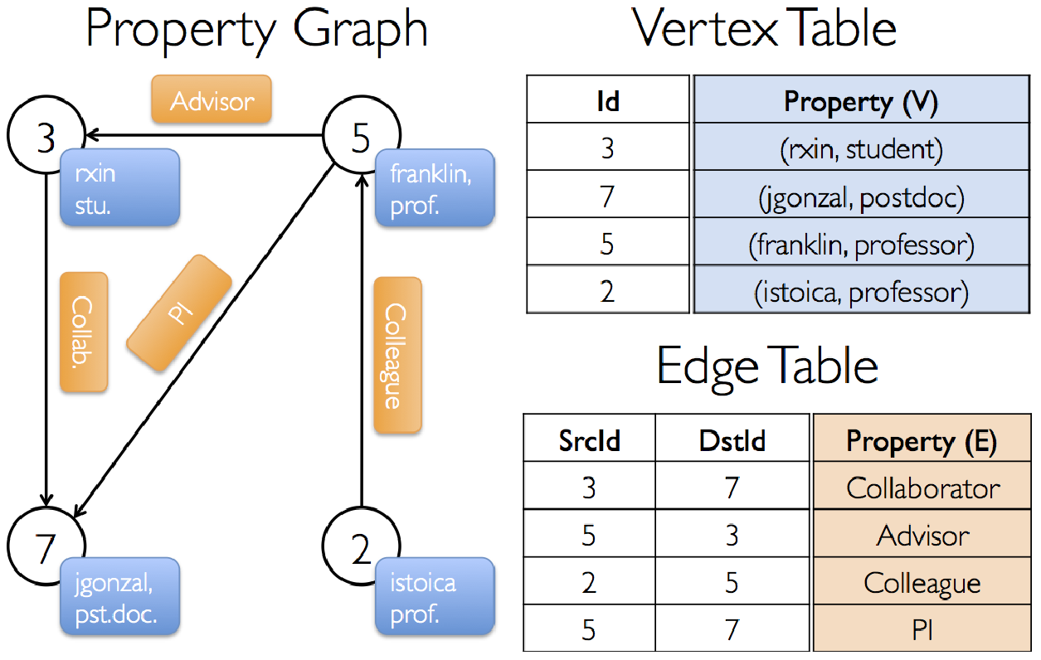
Graph modeling in GraphX
The property graph is parameterized over the vertex (VD) and edge (ED) types
class Graph[VD, ED] {
val vertices: VertexRDD[VD]
val edges: EdgeRDD[ED] }
Graph[(String, String), String]

Slide 43
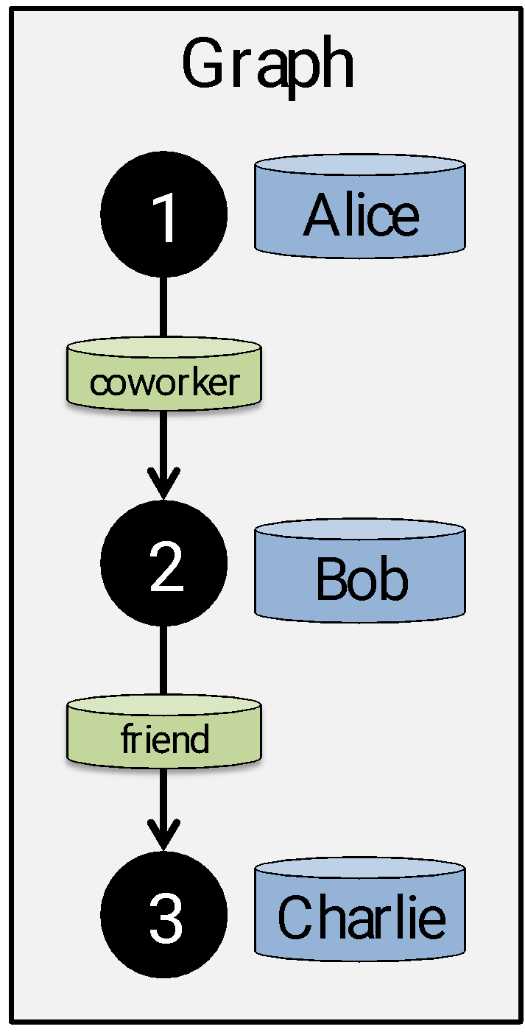
Creating a Graph (Scala)
type VertexId = Long
val vertices: RDD[(VertexId, String)] = sc.parallelize(List(
(1L, “Alice”), (2L, “Bob”), (3L, “Charlie”)))
class Edge[ED]( val srcId: VertexId,
val dstId: VertexId, val attr: ED)
val edges: RDD[Edge[String]] = sc.parallelize(List(
Edge(1L, 2L, “coworker”), Edge(2L, 3L, “friend”)))
val graph = Graph(vertices, edges)

Slide 44
Hello world in GraphX
$ spark*/bin/spark-shell scala> val inputFile = sc.textFile(“hdfs:///tmp/graph/1.txt”)
scala> val edges = inputFile.flatMap(s => { val l = s.split("\t");
l.drop(1).map(x => (l.head.toLong, x.toLong)) })
scala> val graph = Graph.fromEdgeTuples(edges, "") scala> val result = graph.collectNeighborIds(EdgeDirection.Out).map(x =>
println("Hello world from the: " + x._1 + " : " + x._2.mkString(" ")) )
scala> result.collect() // don’t try this @home
Hello world from the: 1 : Hello world from the: 2 : 1 3 Hello world from the: 3 : 1 2

Slide 45
Spark Table Operators
GraphX Table (RDD) operators are inherited from Spark:
map filter groupBy sort union join leftOuterJoin rightOuterJoin
reduce count fold
reduceByKey groupByKey cogroup
cross
zip
sample take
first
partitionBy
mapWith
pipe
save
…

Slide 46
Graph Operators (Scala)
class Graph [ V, E ] { def Graph(vertices: Table[ (Id, V) ], edges: Table[ (Id, Id, E) ]) // Table Views ----------------- def vertices: Table[ (Id, V) ] def edges: Table[ (Id, Id, E) ] def triplets: Table [ ((Id, V), (Id, V), E) ] // Transformations ------------------------------ def reverse: Graph[V, E] def subgraph(pV: (Id, V) => Boolean,
pE: Edge[V,E] => Boolean): Graph[V,E] def mapV(m: (Id, V) => T ): Graph[T,E] def mapE(m: Edge[V,E] => T ): Graph[V,T] // Joins ---------------------------------------- def joinV(tbl: Table [(Id, T)]): Graph[(V, T), E ] def joinE(tbl: Table [(Id, Id, T)]): Graph[V, (E, T)] // Computation ---------------------------------- def mrTriplets(mapF: (Edge[V,E]) => List[(Id, T)],
reduceF: (T, T) => T): Graph[T, E]
}

Slide 47
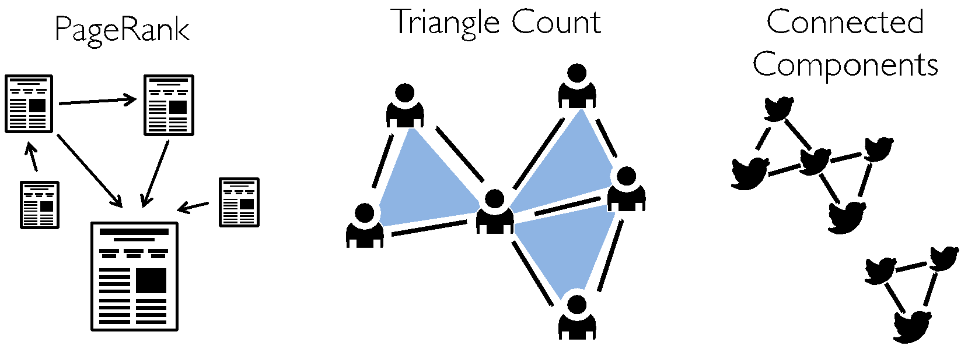
Built-in Algorithms (Scala)
def pageRank(tol: Double): Graph[Double, Double] def triangleCount(): Graph[Int, ED] def connectedComponents(): Graph[VertexId, ED] def stronglyConnectedComponents(numIter:Int):Graph[VertexID,ED] // ...and more: org.apache.spark.graphx.lib (GraphX libraries)

Slide 48
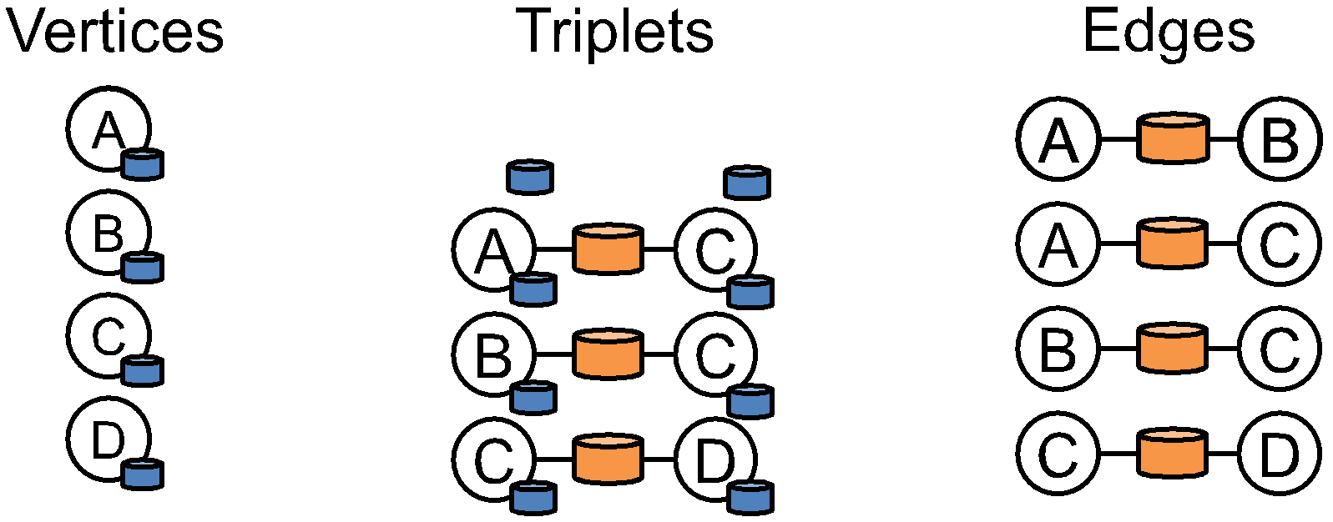
Triplets Join Vertices and Edges
Triplets capture Gather-Scatter pattern from specialized graph processing systems (like Giraph)
Triplets operator joins vertices and edges

Slide 49
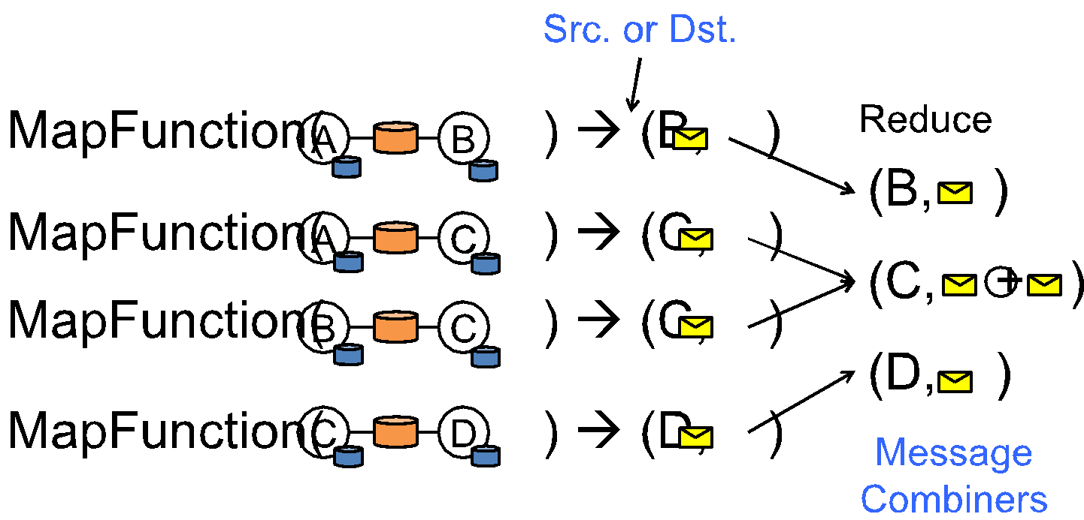
MapReduce Triplets
Map-Reduce triplets collect information about the neighborhood of each vertex:

Slide 50
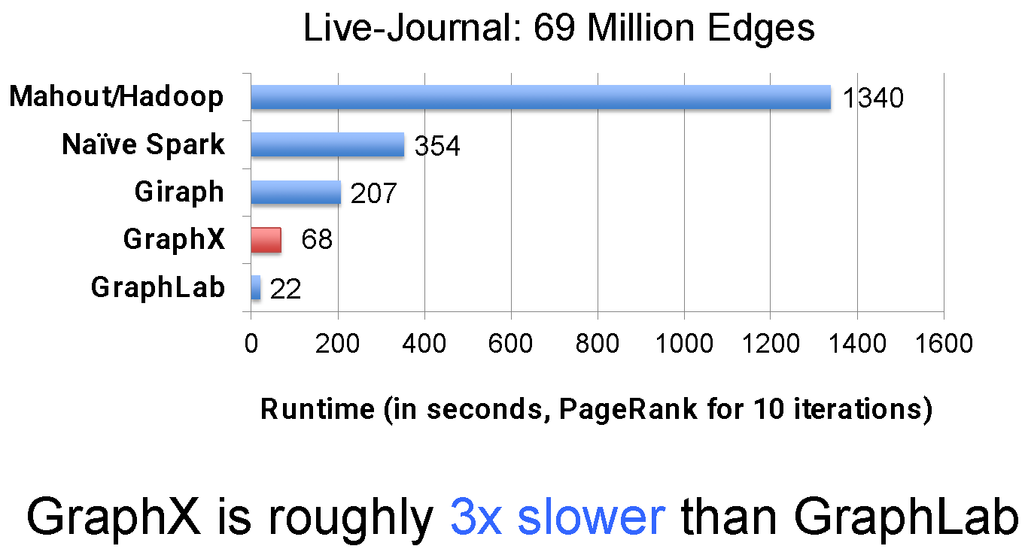
Performance Comparisons

Slide 51
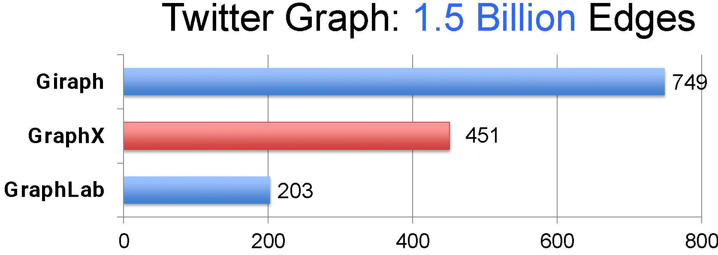
GraphX scales to larger graphs
GraphX is roughly 2x slower than GraphLab
Scala + Java overhead: Lambdas, GC time, …
No shared memory parallelism: 2x increase in communication

Slide 52
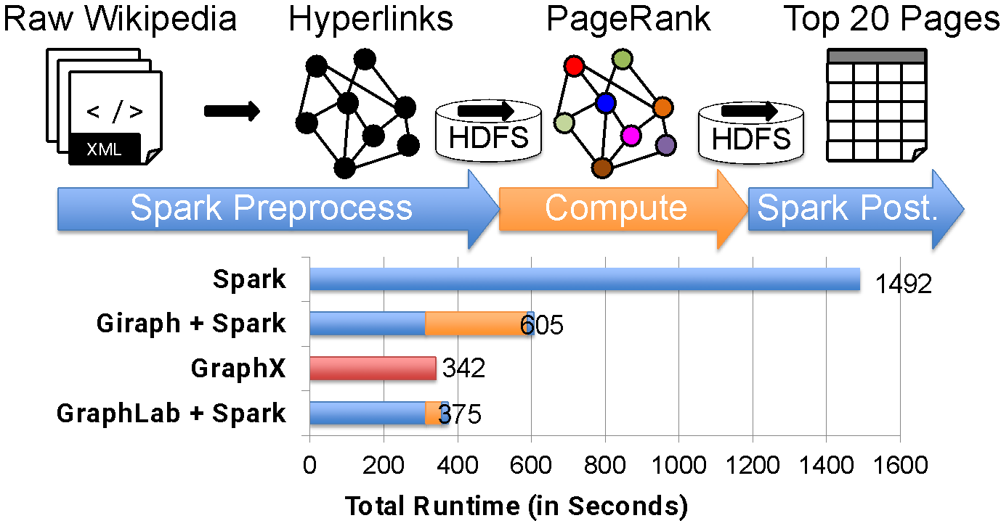
But, a Small Pipeline in GraphX
Timed end-to-end GraphX is faster than GraphLab (and Giraph)

Slide 53
Giraph vs. GraphX
Giraph
An unconstrained BSP framework
Specialized fully mutable, dynamically balanced in-memory graph representation
Procedural, vertex-centric programming model
Part of Hadoop ecosystem
GraphX
An RDD framework
Graphs are “views” on RDDs and thus immutable
Functional-like, “declarative” programming model
Genuine part of Spark ecosystem

